Slide 1
Aviation Accidents Analysis (1919–2022)
A Python-Based Data Analysis Project
By: Nikhil Kumar
Tools: Python | Pandas | Seaborn | Plotly | PyCharm | GitHub

Slide 2

Objective & Scope
Analyze aviation accidents globally (1919–2022).
Identify patterns, causes, and severity trends.
Generate insights using Python-based visualizations.

Slide 3

Dataset Overview
Source: Global aviation accident records (1919–Sept 2022).
Total Records: 21,742
Coverage: 1919–2022 (103 years).
Key Fields: Country, Operator, Aircraft Type, Category, Fatalities, Date.

Slide 4

Data Cleaning & Transformation
Standardized and corrected column names.
Filled missing values for key fields.
Converted dates and fatalities to numeric formats.
Created Damage Type: 'Hull Loss' vs 'Repairable'.
Removed duplicates and standardized country names.

Slide 5
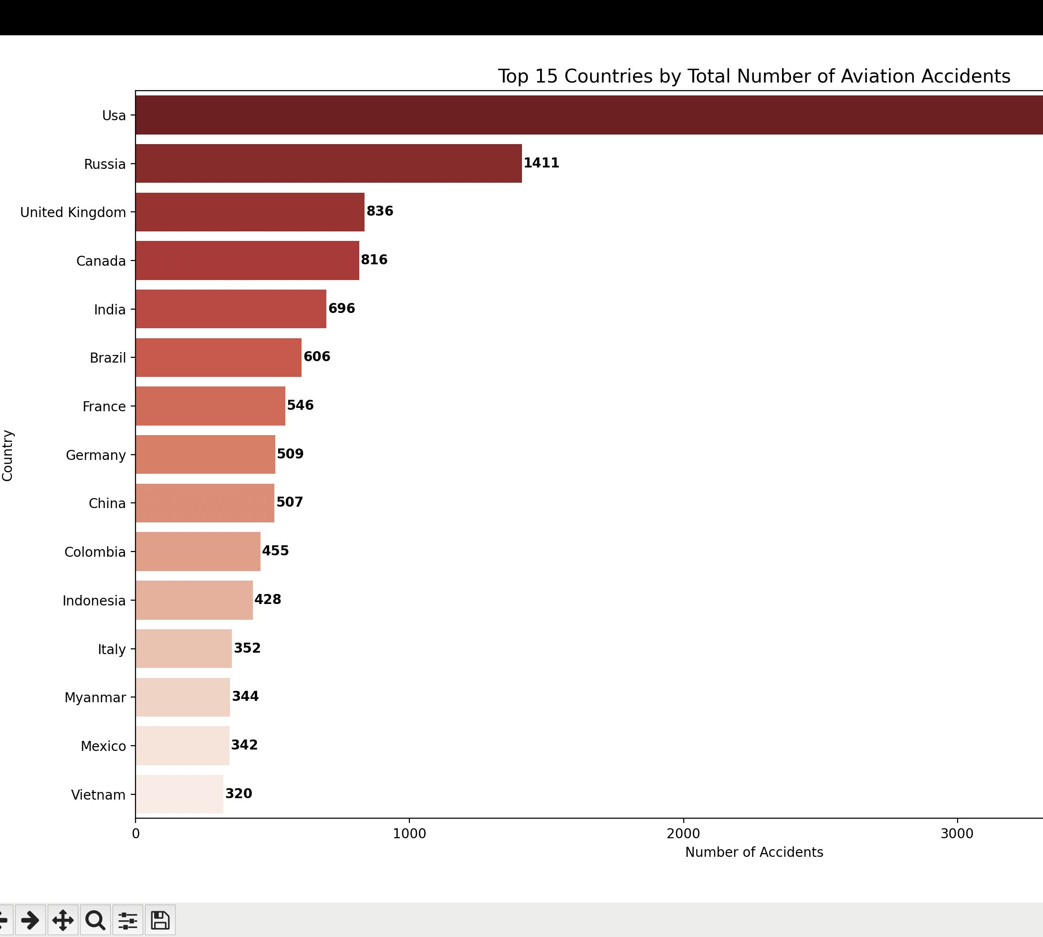
Top 15 Countries by Aviation Accidents
Top 15 countries account for ≈ 57.36% of all accidents.
Highest accident country: USA.
High air traffic regions show greater incident frequency.

Slide 6
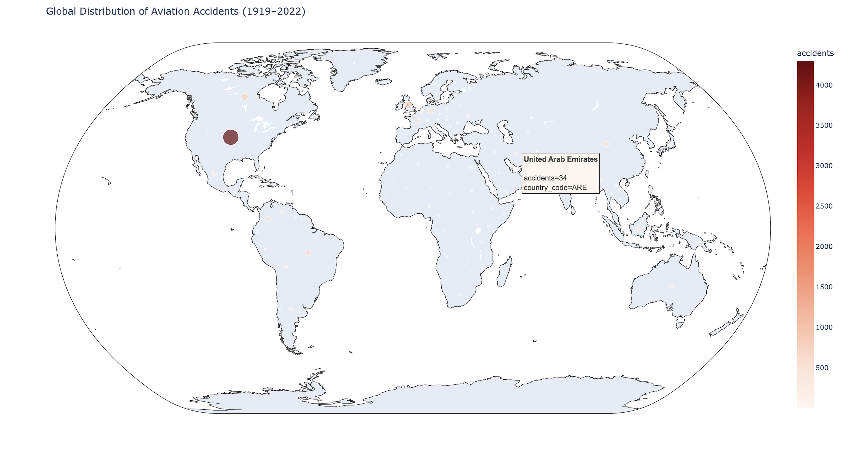
Global Accident Distribution
Accidents concentrated in North America & Europe.
Lower frequency in Africa & Oceania.
Reflects correlation between air traffic and reported incidents.

Slide 7
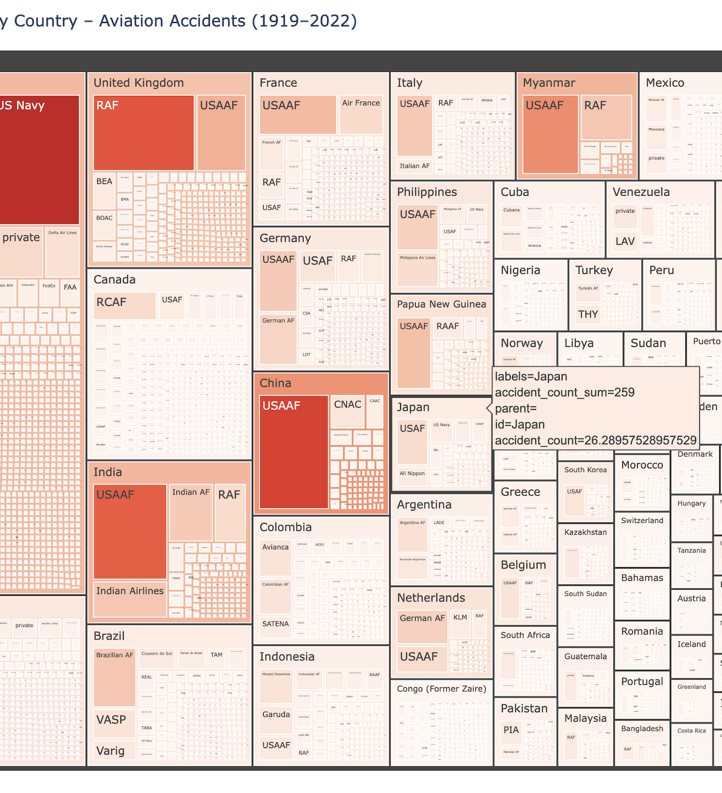
Operator Breakdown by Country
Few large operators dominate the number of accidents.
'Unknown' operator data common in early decades.
Regional differences evident in operator concentration.

Slide 8
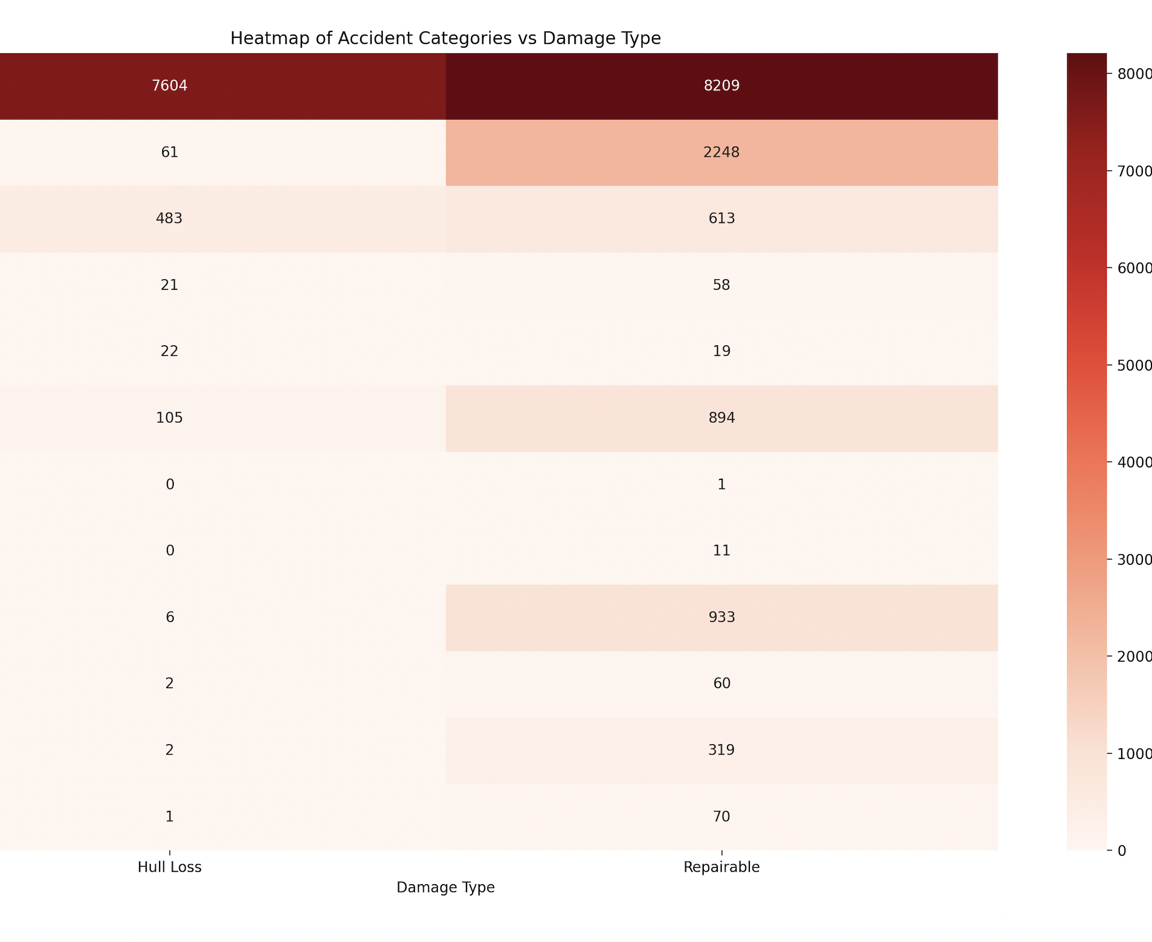
Accident Category vs Damage Type
Hull losses occur mostly during Take-off and Landing phases.
Repairable damages are more common in Ground/Taxiing operations.
Major accident segment: Category A1 (General Aviation).

Slide 9
Key Analytical Insights
Top 15 countries account for 57.36% of all accidents.
Highest accident country: USA.
Fatalities vs Year correlation ≈ 0.0018 (very weak relationship).
Largest segment per top country: A1 (General Aviation).
Safety improving over decades despite rising traffic.

Slide 10

Deadliest Aircraft Types
Boeing 747-168B — 312 fatalities per crash.
Lockheed L-1011 TriStar 200 — 301 fatalities per crash.
Boeing 777-2H6ER — 298 fatalities per crash.
Airbus A300B4-220 — 234 fatalities per crash.
These represent single catastrophic events with high impact.

Slide 11

Operators with Highest Fatalities
USAF — 5,008 fatalities.
USAAF — 3,958 fatalities.
RAF — 2,216 fatalities.
US Navy — 1,980 fatalities.
Military operators dominate fatality counts historically.

Slide 12
Conclusions
Accidents align with air traffic density by region.
Fatalities decreasing steadily — aviation safety improving.
General Aviation (A1) dominates top country incidents.
Python enabled efficient exploration of over 21,000 records.

Slide 13
Tools & Skills Demonstrated
Environment: PyCharm | GitHub.
Libraries: Pandas, Matplotlib, Seaborn, Plotly, PyCountry.
Skills: Cleaning, Grouping, Filtering, Visualization, Correlation Analysis.

